Slide 1
Slime

Slide 2
What is Slime?
Is it a solid?
Is it a LIQUID?
Notes:
Solid - Have you been able to roll it into a ball? Or form it into a shape?
Liquid – does it flow like water? Not really
But when you leave your shape on the counter it will eventually flow into a flat pancake.
It is a “Non Newtonian fluid” Fluid is another name for

Slide 3
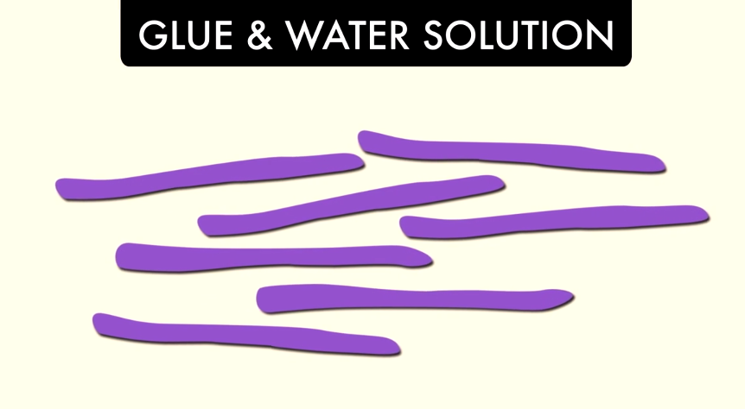
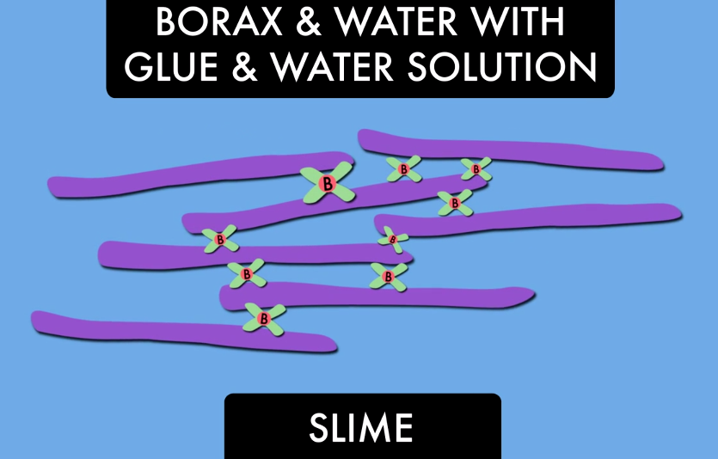
Let’s make Slime
If we zoomed in with a microscope we’d see that Glue contains long chains of molecules called polymers
We’re going to use the chemicals in Contact Lense Solution to link them up so they stick together

Slide 4
Is your Slime a solid or a Liquid?
Can you make a shape with it?
Does it stay in that shape?
Liquids that flow very slowly are called:
  Non Newtonian Fluids

